Slide 1
Interprocess communication (IPC)
Interprocess communication (IPC) is Interprocess communication is the mechanism provided by the operating system that allows processes to communicate with each other..

Slide 2
Why Interprocess Communication is Necessary
IPC lets different programs run in parallel, share data, and communicate with each other. It’s important for two reasons:
It speeds up the execution of tasks.
It ensures that the tasks run correctly and in the order that they were executed.
IPC is essential for the efficient operation of an operating system.

Slide 3
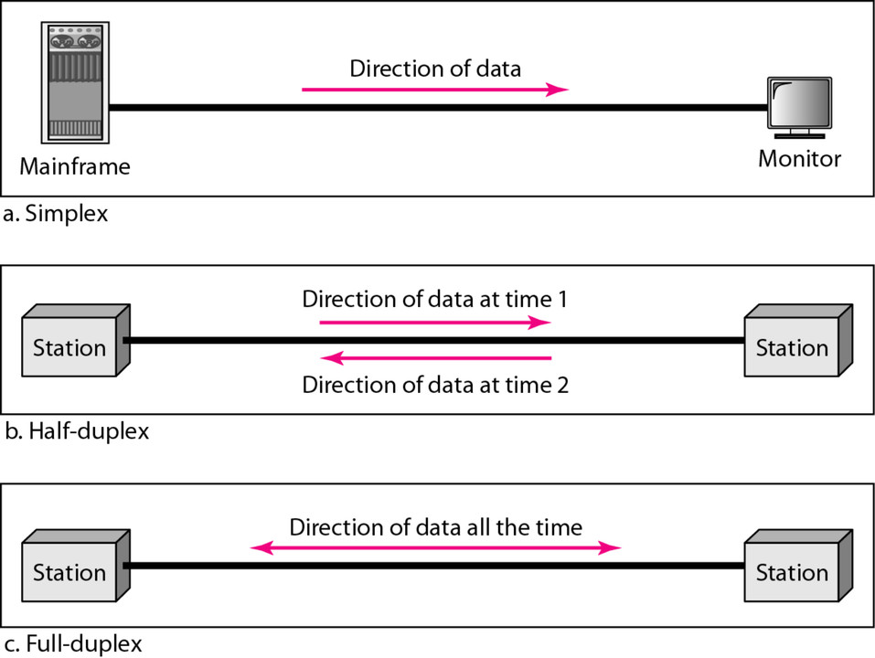
Types of communication

Slide 4

Inter-process Communication

Slide 5


Slide 6
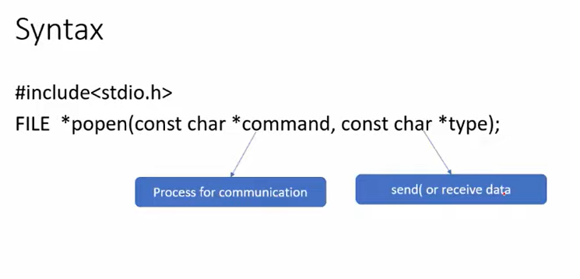
When popen works it will create a file stream which links two processes.
W-writing/send
R-read/receive

Slide 7
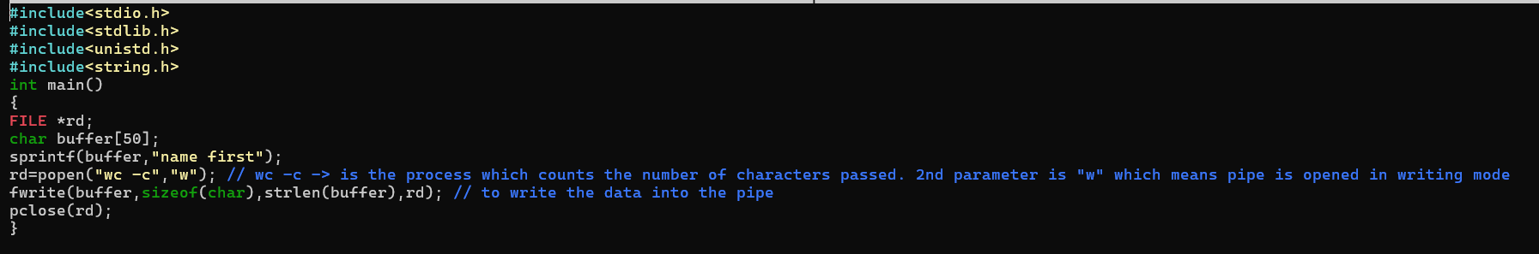
POPEN used to send msg

Slide 8
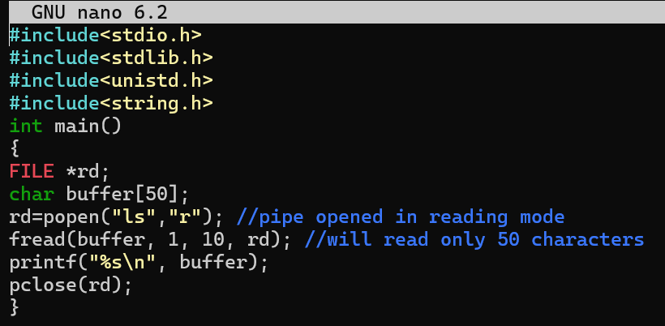
POPEN used to receive msg

Slide 9


Slide 10
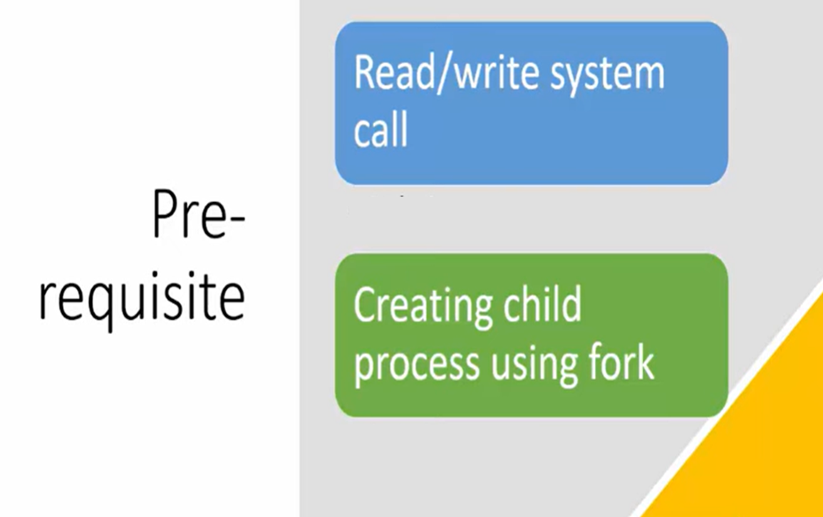

Slide 11
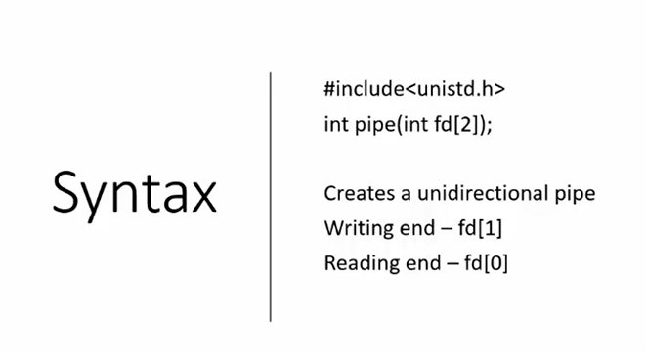
II Method PIPE method

Slide 12
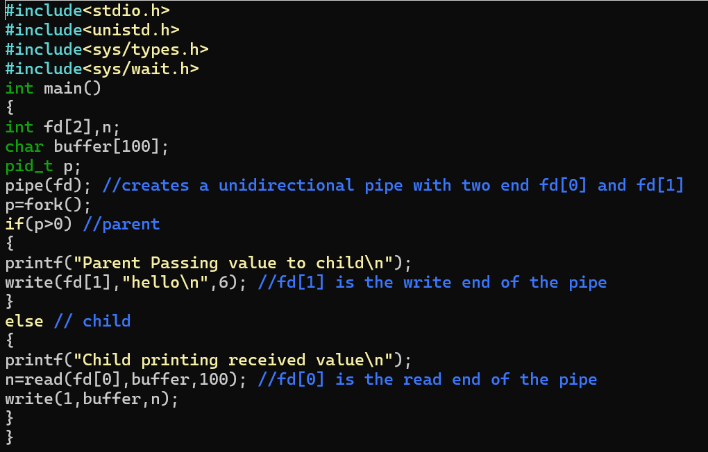
Parent passes a mgs. to the child using pipe()

Slide 13


Slide 14
FIFO special file is similar to a pipe, except that it is created in a different way. Instead of being an anonymous communications channel, a FIFO special file is entered into the filesystem by calling mkfifo().
Once you have created a FIFO special file in this way, any process can open it for reading or writing, in the same way as an ordinary file.
However, it has to be open at both ends simultaneously before you can proceed to do any input or output operations on it. Opening a FIFO for reading normally blocks until some other process opens the same FIFO for writing, and vice versa. See fifo(7) for nonblocking handling of FIFO special files.

Slide 15

mkfifo

Slide 16
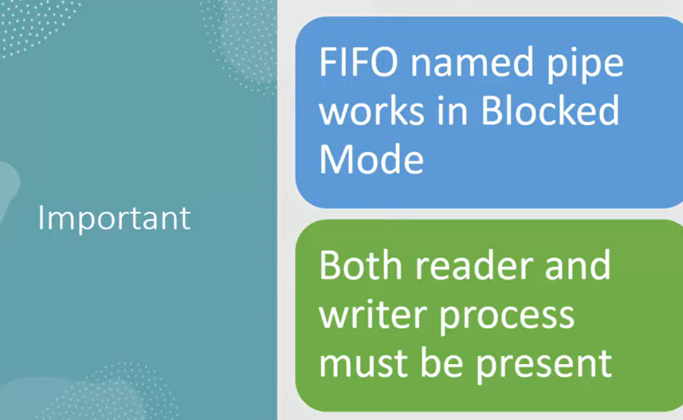

Slide 17
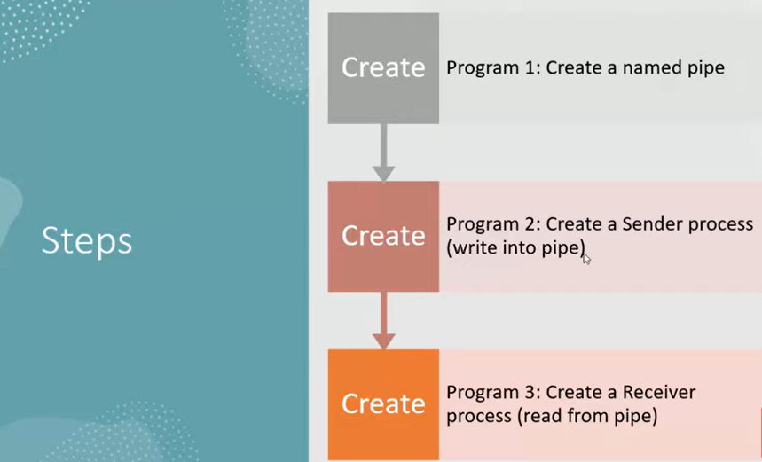

Slide 18
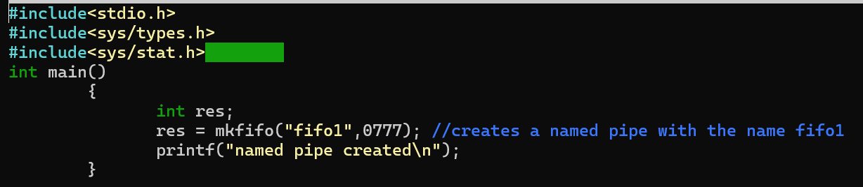
creates a named pipe with the name fifo1 usi g “mkfifo”

Slide 19
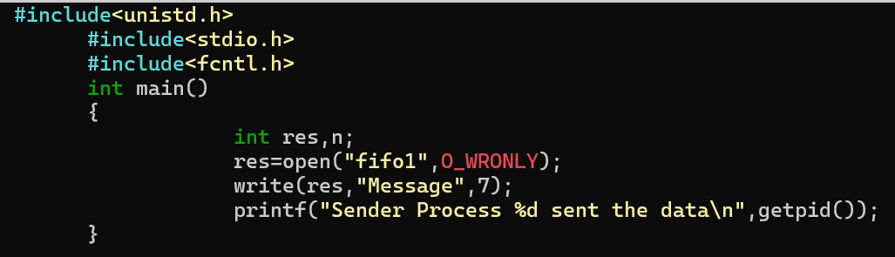
Sender code

Slide 20
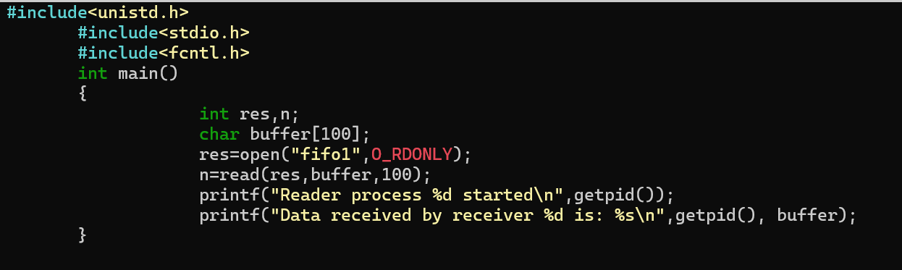
Receiver code

Slide 21
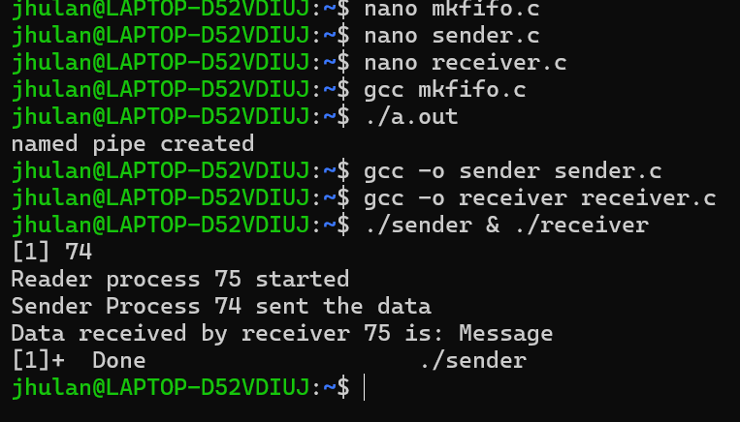
How to run: RUm mkfifo.c first then sender receiver code
Its works in a block mode means sender & receiver program should run together

Slide 22
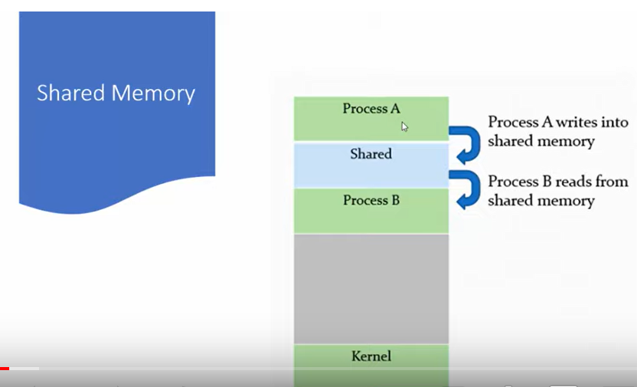

Slide 23
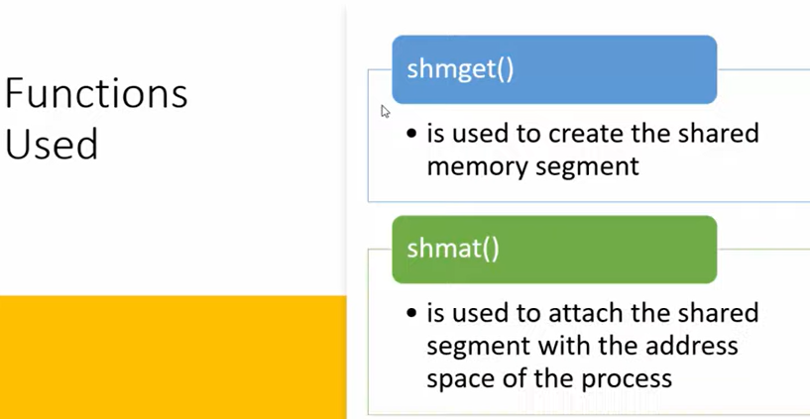

Slide 24


Slide 25
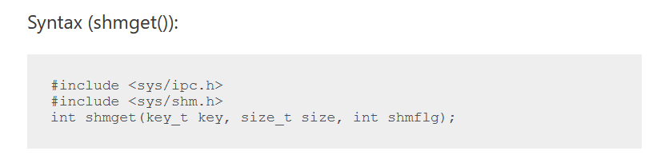
Sendermemory.c
The first parameter specifies the unique number (called key) identifying the shared segment.
The second parameter is the size of the shared segment e.g. 1024 bytes or 2048 bytes.
The third parameter specifies the permissions on the shared segment.
On success the shmget() function returns a valid identifier while on failure it return -1.

Slide 26
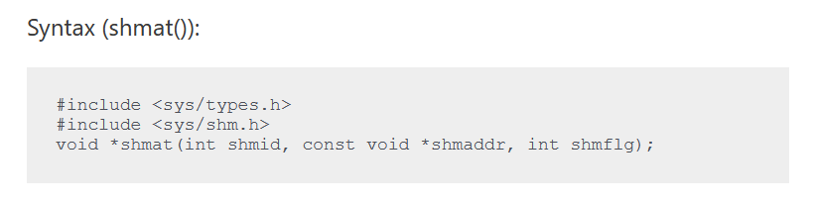
Receivermemory.c
shmat() is used to attach the created shared segment with the address space of the calling process.
The first parameter here is the identifier which shmget() function returns on success.
The second parameter is the address where to attach it to the calling process. A NULL value of second parameter means that the system will automatically choose a suitable address.
The third parameter is ‘0’ if the second parameter is NULL, otherwise, the value is specified by SHM_RND.

Slide 27



Slide 28
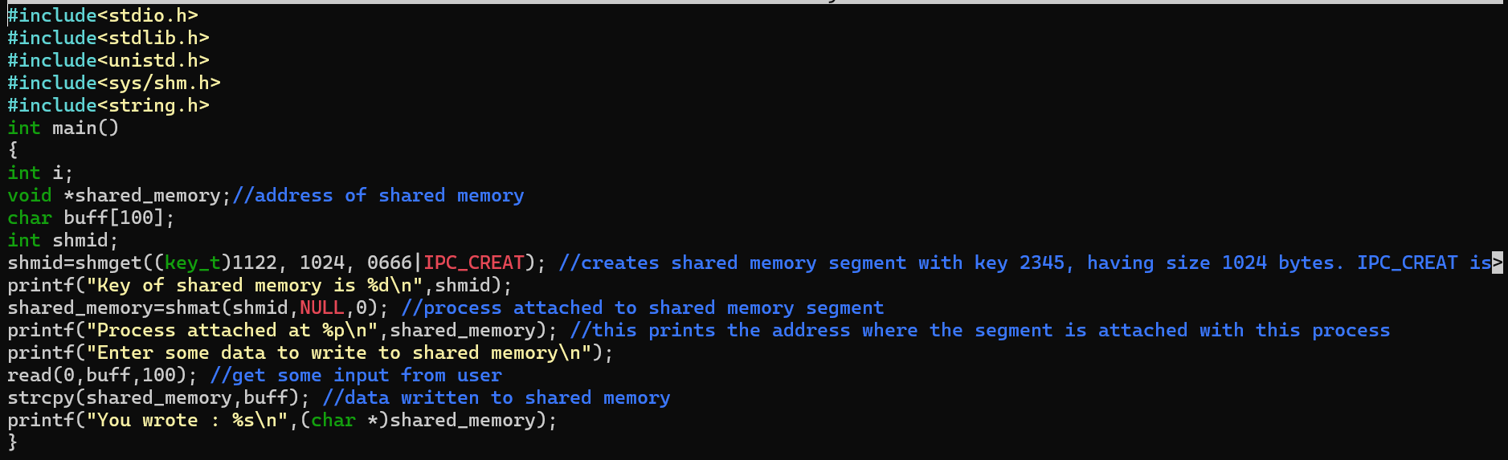
Sender code of shared memory

Slide 29
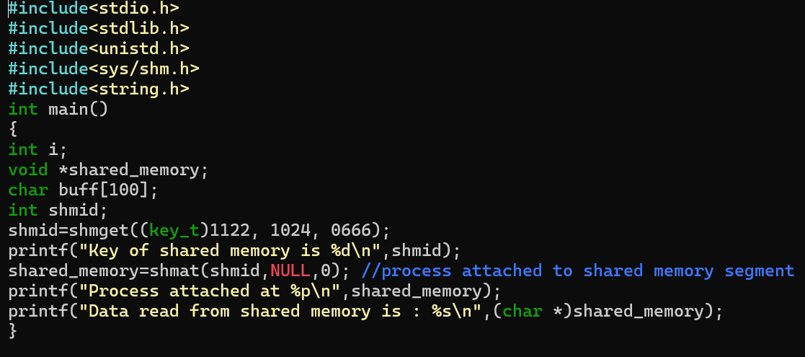
Receiver code of shared memory

Slide 30
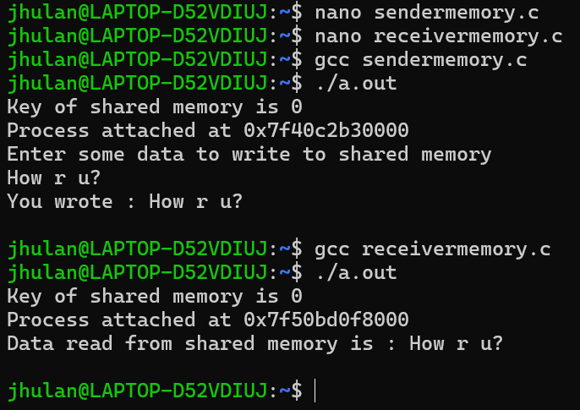
How to run:

Slide 31
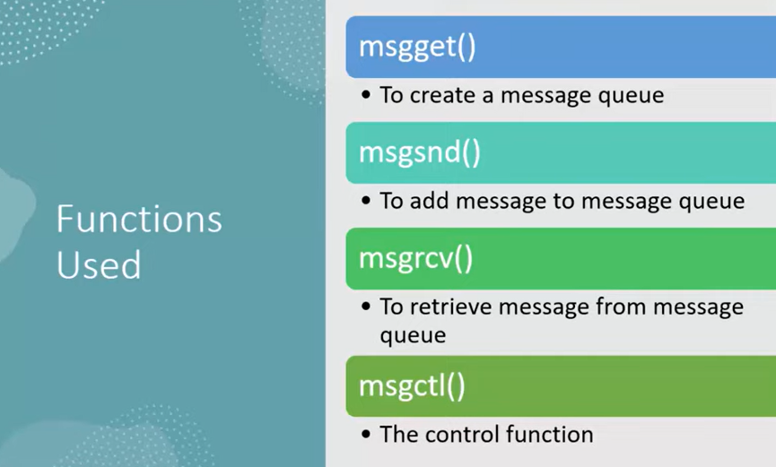

Slide 32
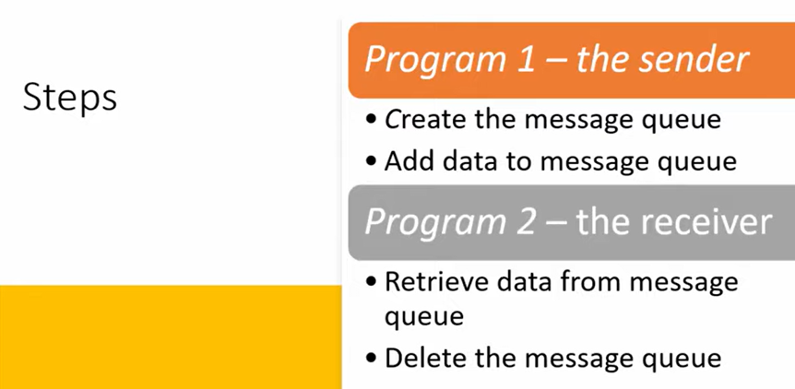
Messagequeue1.c,messagequeue2.c

Slide 33
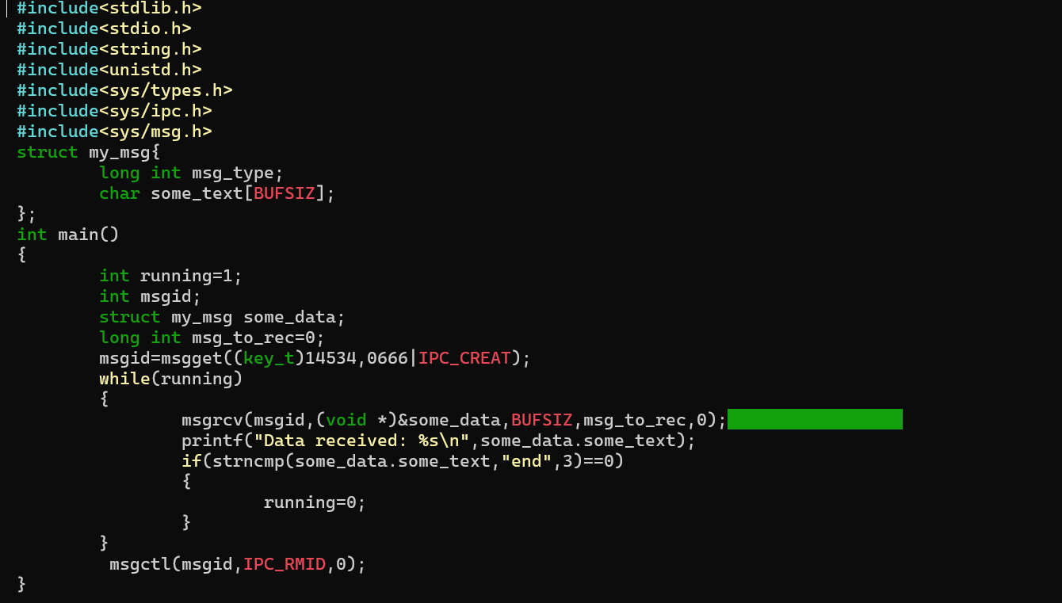
Sender code of message queue

Slide 34
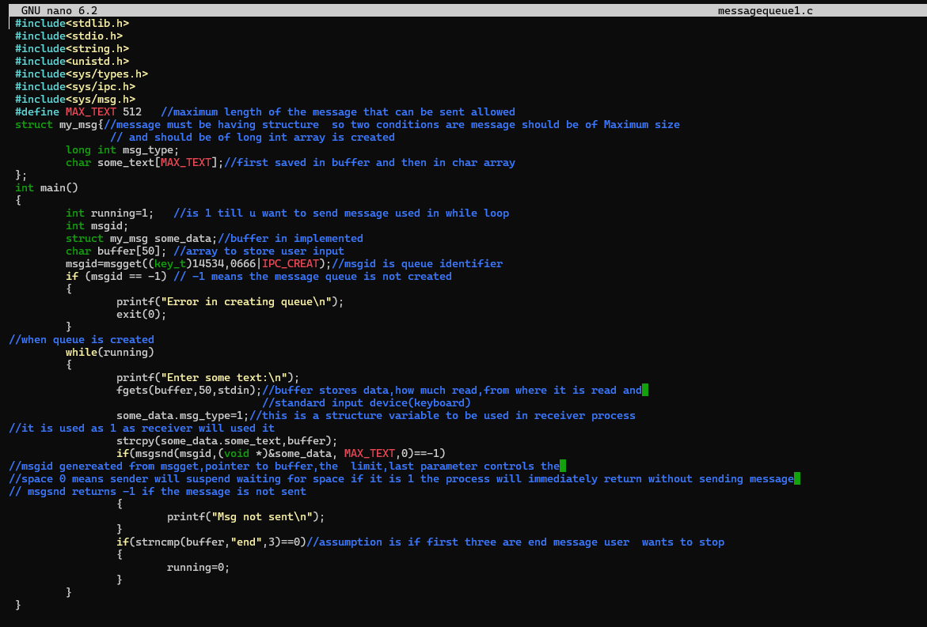
Receiver code of message queue

Slide 35
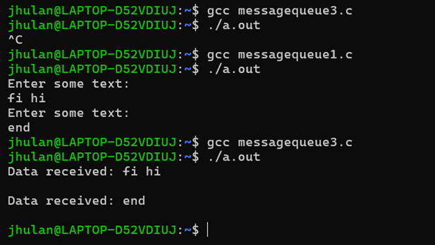
How to run:

